Slide 1
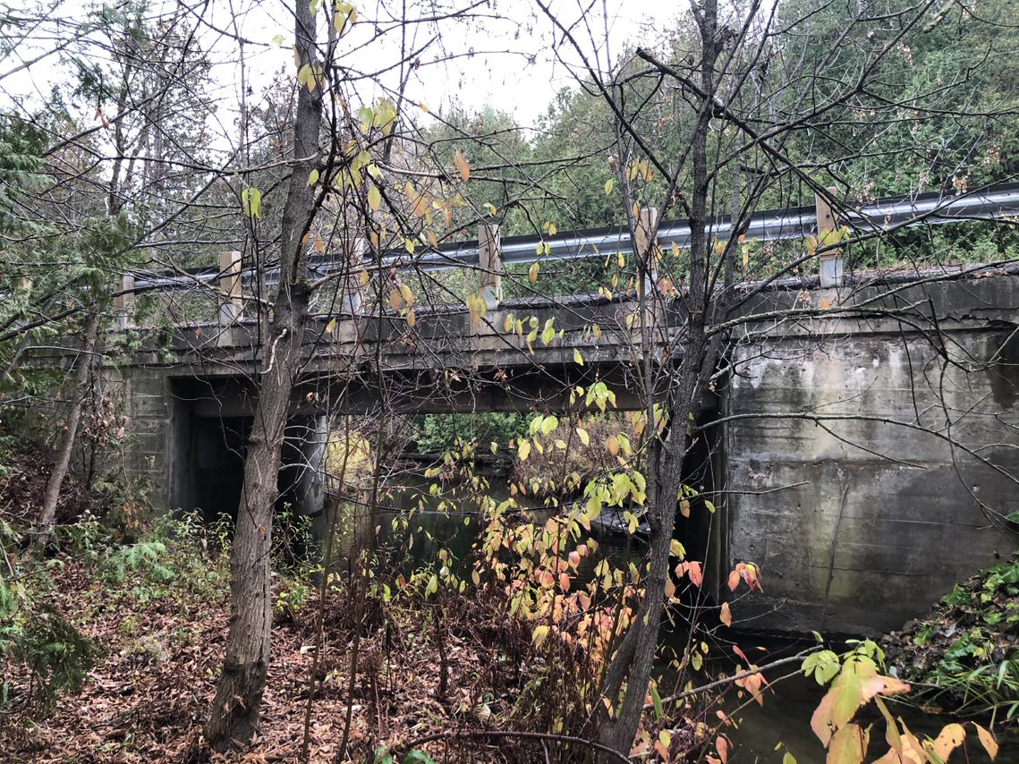
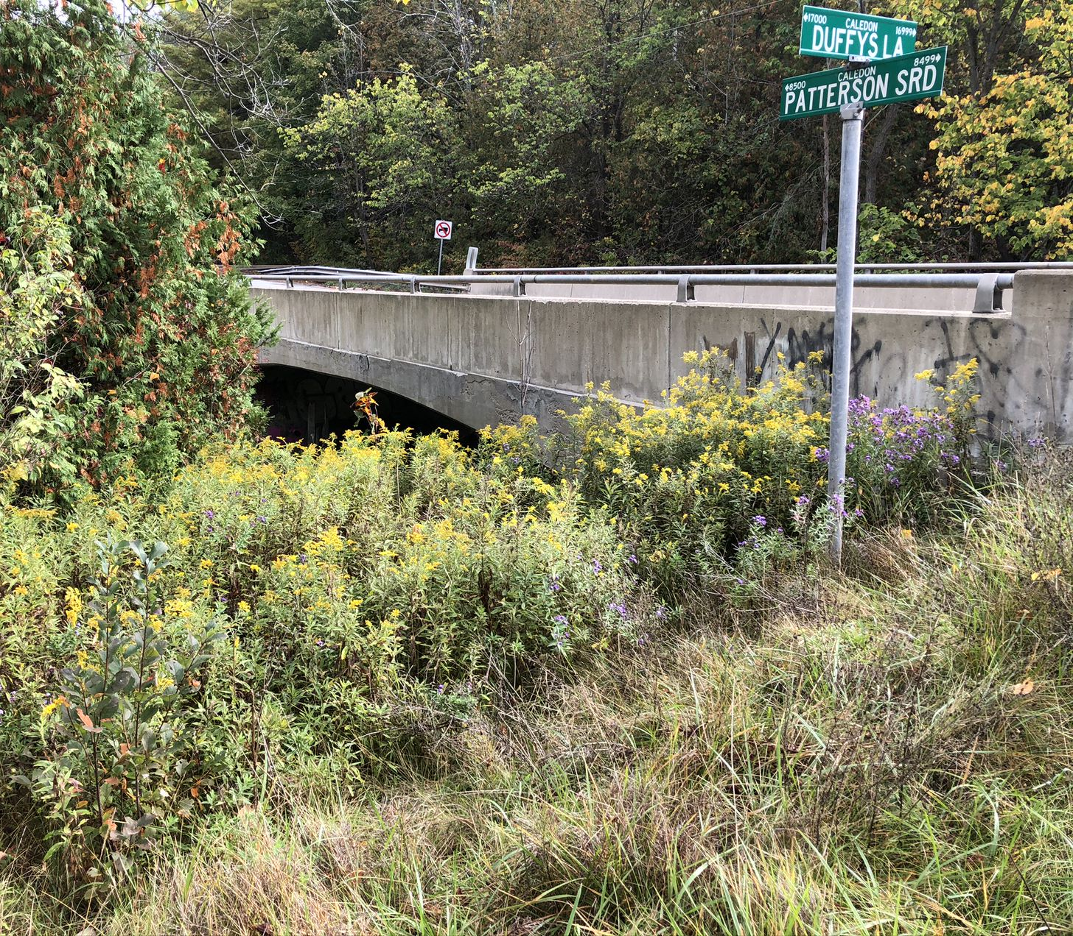
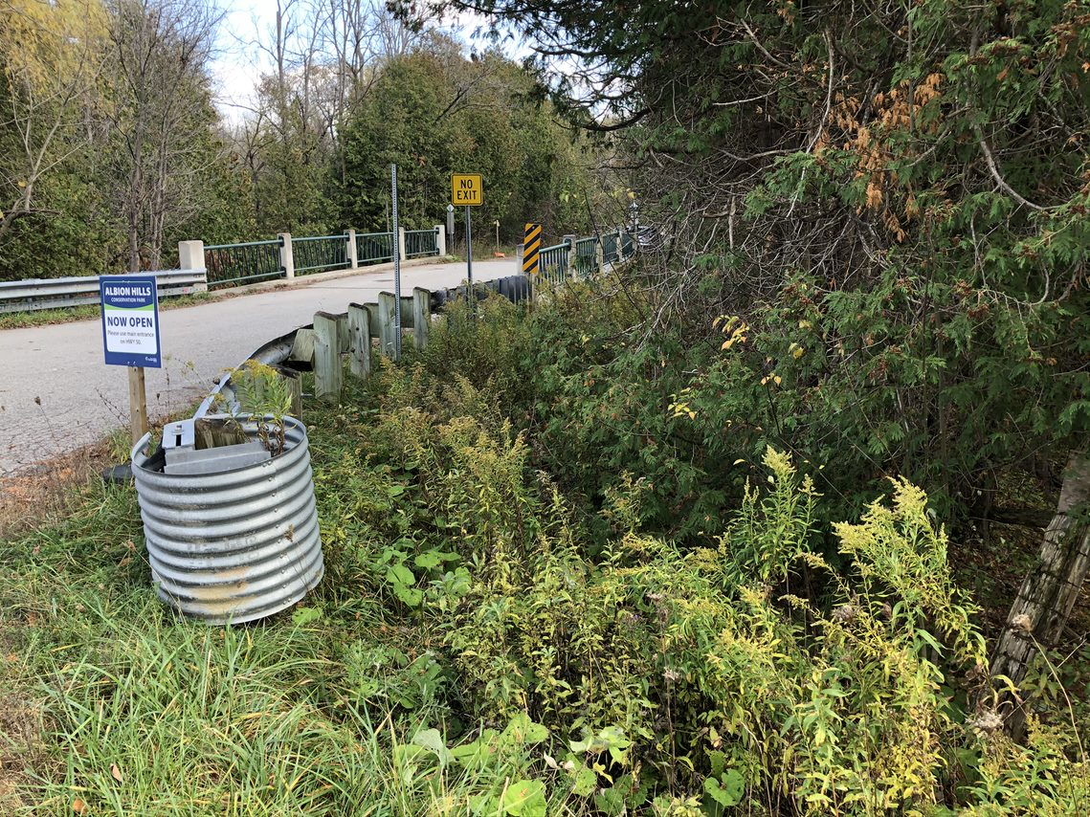

Patterson Sideroad Bridges 1 & 2 and Duffy’s Lane Bridge Improvements
Municipal Class EA
Town of Caledon
Public Information Centre (PIC)
Welcome
Notes:
Welcome to the online Public Information Centre for the Municipal Class Environmental Assessment study for improvements to Patterson Sideroad Bridge 1 and Bridge 2, and Duffy’s Lane Bridge in the Town of Caledon. On behalf Town of Caledon and the study team, thank you for your interest and participation in this project.

Slide 2
Land Acknowledgement
Indigenous Peoples have unique and enduring relationships with the land. Indigenous Peoples have lived on and cared for this land throughout the ages. We acknowledge this and we recognize the significance of the land on which we gather and call home.
We acknowledge the traditional Territory of the Huron-Wendat and Haudenosaunee peoples, and the Anishnabek of the Williams Treaties. This land is part of the Treaty Lands and Territory of the Mississaugas of the Credit First Nation.
We honour and respect Indigenous heritage and the long-lasting history of the land and strive to protect the land, water, plants and animals that have inhabited this land for the generations yet to come.

Slide 3
Project Purpose
Problem / Opportunity Statement:
As part of the Town of Caledon’s Asset Management Strategy, improvements are being considered for bridges and culverts due to the wear and tear on existing infrastructure as a result of increased traffic use.
The Town has initiated a Schedule ‘B’ Municipal Class Environmental Assessment (EA) to consider options for improvements to Patterson Sideroad Bridge 1, Patterson Sideroad Bridge 2 and Duffy’s Lane Bridge.
Purpose of this PIC is to:
Present the Problem/Opportunity Statement
Provide an overview of the Municipal Class Environmental Assessment process
Provide information on the existing environment of the Study Area
Present an evaluation of the alternative solutions
Obtain input on the alternative solutions
Identify next steps
2
Notes:
The Town of Caledon’s Asset Management Strategy identified the need for improvements to the Patterson Side Road Bridge 1, Bridge 2, and Duffy’s Lane Bridge as a result of wear and tear on existing infrastructure due to increased traffic use. The Municipal Class Environmental Assessment Study is being conducted to consider options for the improvement of these Bridges.
This Public Information Centre will provide an overview of the Municipal Class Environmental Assessment process, present information about the Study Area and the alternative solutions being considered, as well as describe the next steps in the process. Following the presentation, we invite you to offer your comments on this project, the evaluation of the solutions, and the engagement materials presented on this platform. Information on how to submit your input to this Study is provided at the end of the presentation. Your input is appreciated and will be considered by the Study Team in the evaluation of the preferred solution.

Slide 4
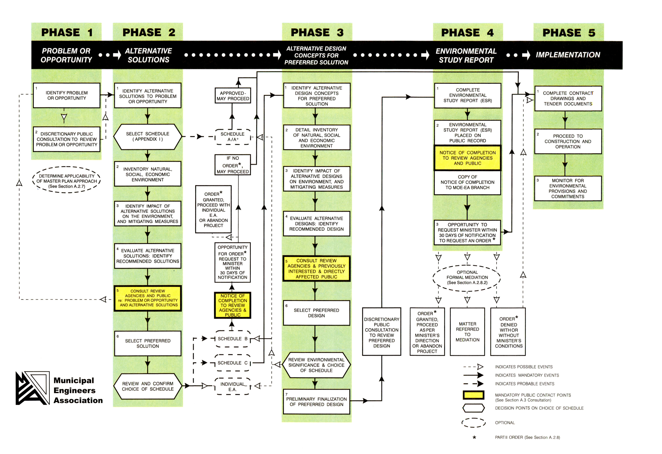
Municipal Class EA Process
This project is being considered as a Schedule ‘B’ Project (Phases 1 and 2), as defined in the Municipal Engineers Association Class EA document. The appropriate Schedule is reviewed at the end of Phase 2 of the EA Process.
We Are Here
3
Notes:
The Study is being completed as a Schedule B project in accordance with the Municipal Class Environmental Assessment process, which is an approved process under the Ontario Environmental Assessment Act. An overview of the EA process is illustrated on the flow chart shown on this slide. The Study is currently in Phase 2, where the Study Team engages with interested parties and the public about the project and the alternative solutions that are being considered, as highlighted in the red box.

Slide 5
Municipal Class EA Process
Phase 1- Problem or Opportunity
  Review available information and studies
  Identify the Problem or Opportunity
  Notice of Commencement
What is there now?
What do we need?
Phase 2- Alternative Solutions
  Identify Alternative Solutions
  Identify Impacts and Mitigation Measures
  Evaluate Alternative Solutions
  Select Preferred Solution
  Confirm EA Schedule (Schedule B or C)
Public Information Centre
What are the options to meet our needs?
What do the options look like?
What is the cost of the options?
What is the impact to the environment?
  Notice of Completion and Public Review
Project File Report
  Document the EA planning process for public review
6
Notes:
As per the EA process, information about the Study Area is reviewed to develop the Problem or Opportunity Statement in Phase 1. In Phase 2, a Notice of Commencement for the study is issued, and input from the public is invited for consideration in the planning and design of the project. Feasible solutions are identified and evaluated at a broad level with input from agencies, Indigenous communities and stakeholders toward a recommendation for a preferred solution. At the end of Phase 2, the appropriate EA planning Schedule is confirmed to ensure the suitable process is being followed.
At the conclusion of the Study, the EA planning process is documented in a Project File Report and made available for public review, prior to being approved by the municipality and proceeding to design and implementation of the project.

Slide 6
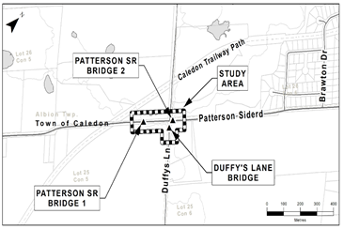
Study Area
The Study Area includes:
Patterson Sideroad Bridge 1: located approximately 160 m west of Duffy’s Lane
Patterson Sideroad Bridge 2: located approximately 20 m east of Duffy’s Lane
Duffy’s Lane Bridge: located approximately 30 m southeast of Patterson Sideroad
Patterson Sideroad is currently a two-lane paved rural collector road with gravel shoulders and roadside drainage ditches.
Adjacent lands include rural residential properties, conservation lands and wooded areas
Duffy’s Lane south of Patterson Sideroad serves as a secondary entrance to the Albion Hills Conservation Park and one residential property. It is a “No Exit” roadway.
The Caledon Trailway Path is located northwest of the Study Area.
Patterson Bridge 1 and Duffy’s Lane Bridge cross the same tributary of the Humber River. Patterson Bridge 2 crosses the Humber River.
The Village of Palgrave is located to the northeast of the Study Area.
5
Notes:
The Study Area includes Patterson Sideroad Bridge 1: located approximately 160 m west of Duffy’s Lane, Patterson Sideroad Bridge 2: located approximately 20 m east of Duffy’s Lane, and Duffy’s Lane Bridge: located approximately 30 m southeast of Patterson Sideroad. Patterson Sideroad is a two-lane, paved, rural collector road with gravel shoulders and roadside drainage ditches. Duffy’s Lane south of Patterson Side Road serves as a secondary entrance to the Albion Hills Conservation Park. It is a “No Exit” roadway and services a secondary entrance for a municipal address. Patterson Bridge 1 and Duffy’s Lane Bridge cross the same tributary of the Humber River, while Patterson Bridge 2 crosses the Humber River. Adjacent lands include rural residential properties, conservation lands and wooded areas. The Caledon Trailway Path is located northwest of the Study Area and the Village of Palgrave is located to the northeast of the Study Area.

Slide 7
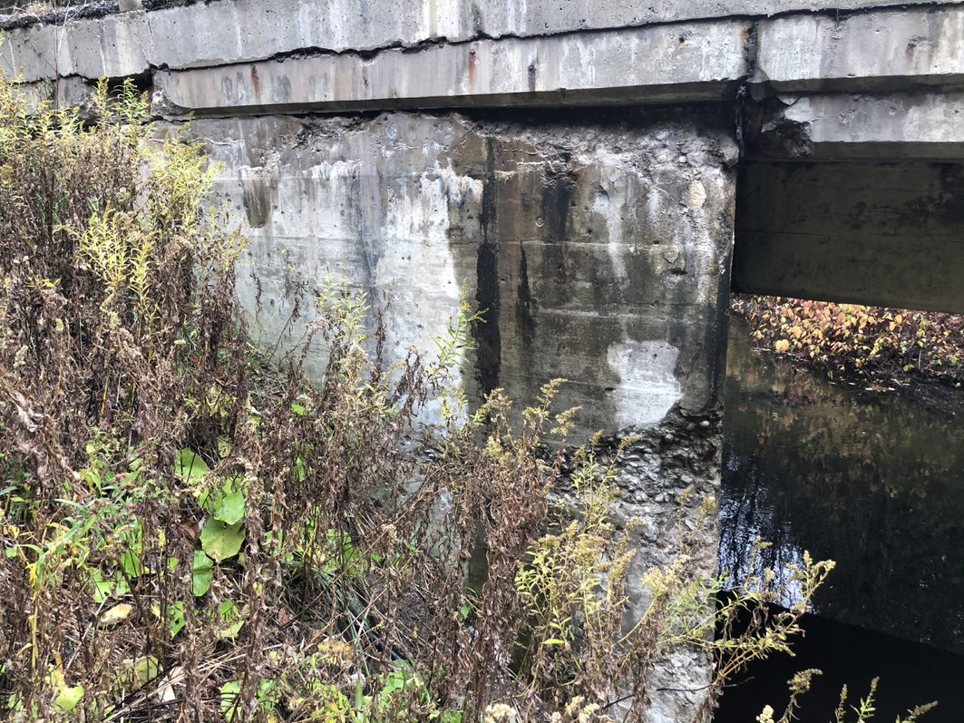
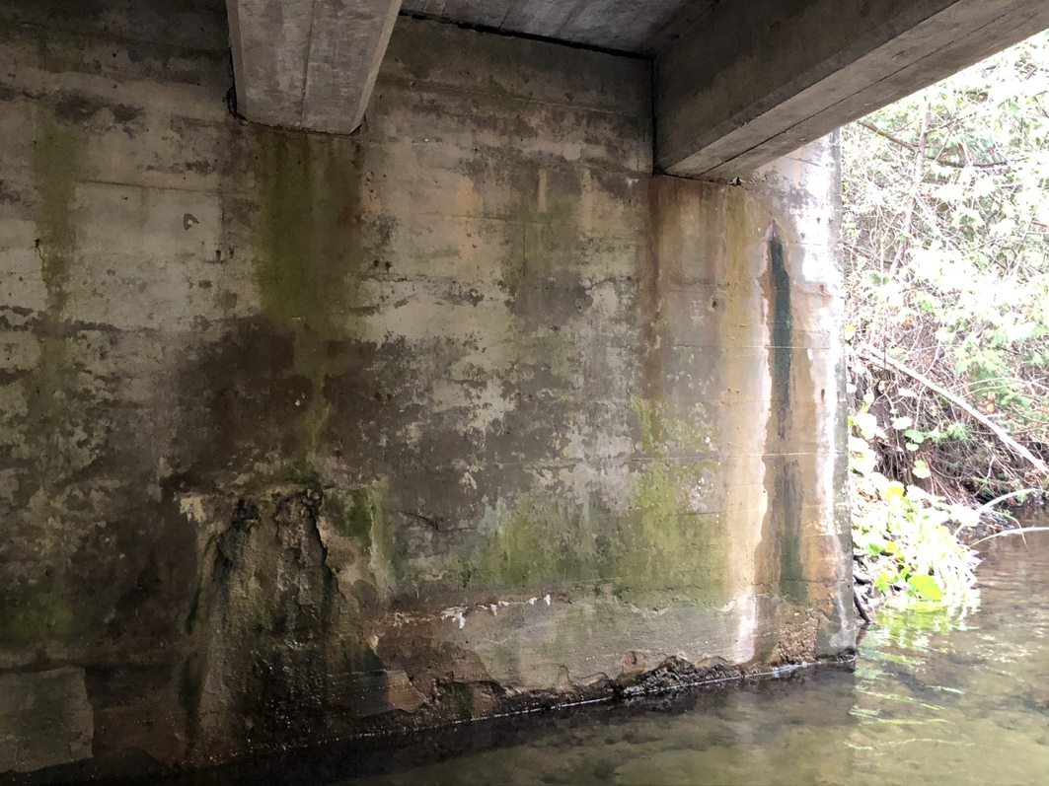
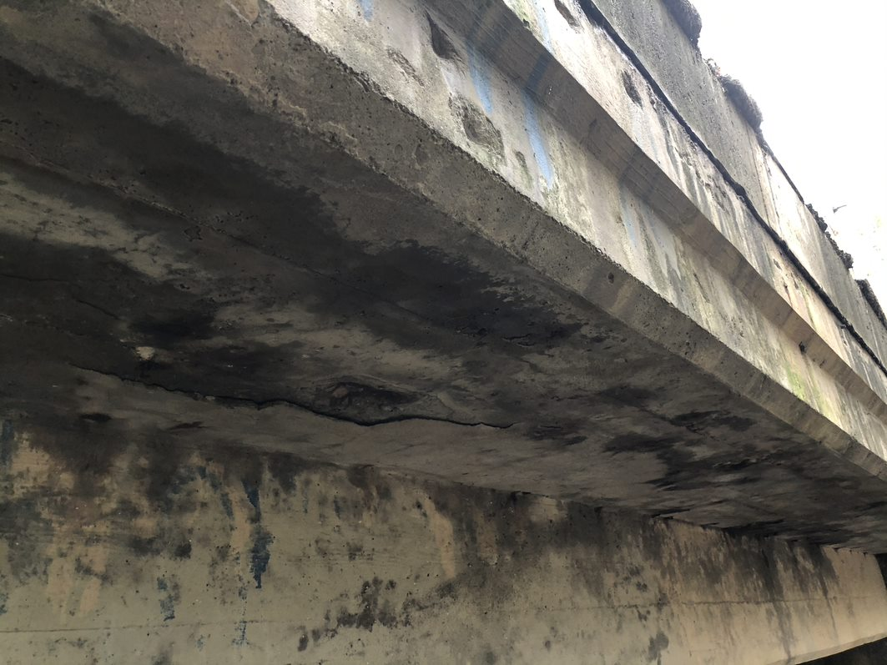
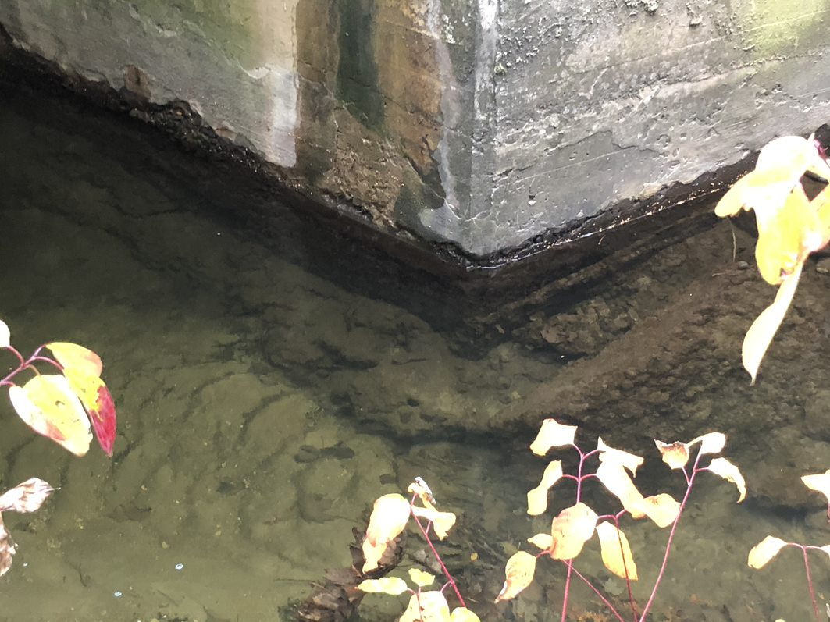
Patterson Sideroad Bridge 1
The existing bridge is a narrow 2-lane, cast-in-place concrete T Beam structure. The bridge has a 7.0 m (+/-) span, an overall structure width of 7.4 m (+/-) and a 6.4 m driving platform width between concrete barriers. The bridge is located over a tributary of the Humber River on Patterson Side Road, 160 m west of Duffy’s Lane.
.
Physical Condition:
Age: Unknown, estimated to be circa 1950s.
Rehabilitation at unknown date. Barrier removed and curb height increased. Curb-mounted guiderail constructed. Fill above structure increased from 200 mm to 500-700 mm.
Structure likely not designed for current truck loading or additional fill and may require load limits if not replaced.
Structure is in fair physical condition overall, with localized moderate to severe defects (wet areas, delaminations, spalls, etc.) on abutments, wingwalls and soffit.
Noted physical defects at the structure could be repaired as part of a major rehabilitation of the bridge by completing concrete patch repairs.
Structure is not well aligned with the watercourse.
Spalls on Wingwall
Spalls on Abutment
Delamination on Soffit
Scour at Footing
Notes:
The Patterson Side Road Bridge 1 is a narrow 2-lane concrete structure, estimated to have been built in the 1950s with rehabilitation of the barrier, curb and guiderail being completed at an unknown date. The bridge has an overall structure width of 7.4m and a driving platform of 6.4 m, as measured between concrete barriers. The bridge crosses a tributary of the Humber River, at a skewed angle to the road. Overall, the bridge is in fair physical condition with some moderate to severe defects which could be repaired as part of a major rehabilitation of the bridge, however, the bridge is likely not designed for current truck loading may require load limits to be put in place.

Slide 8
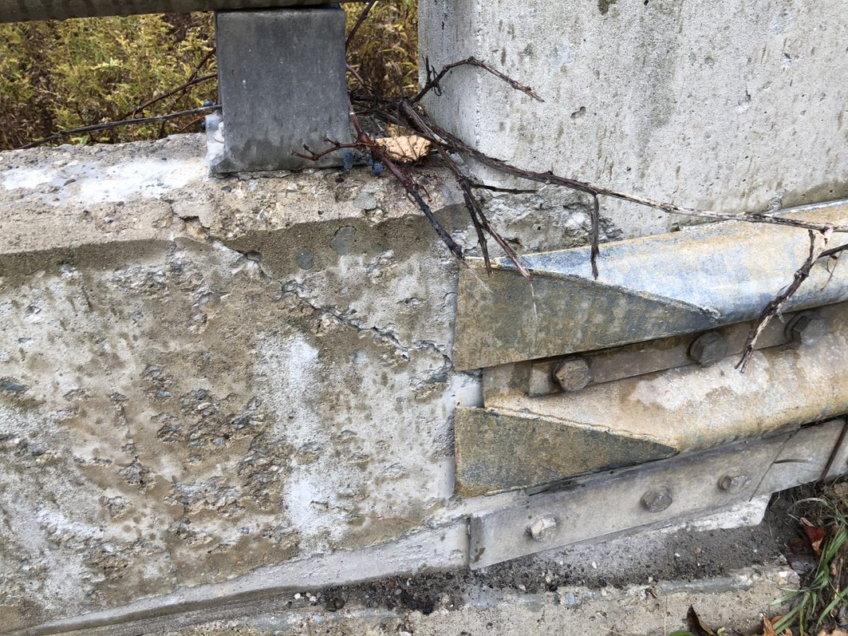
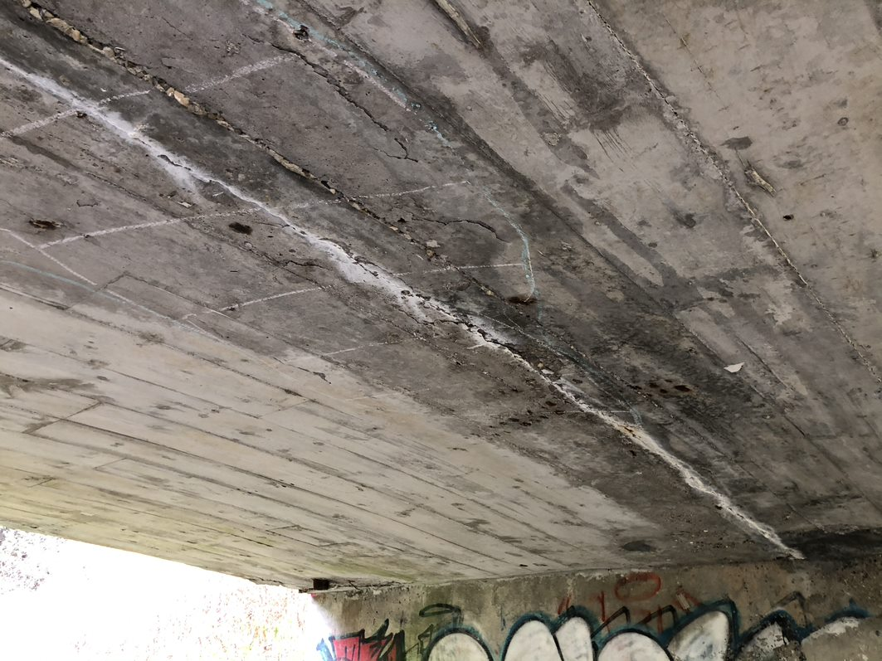
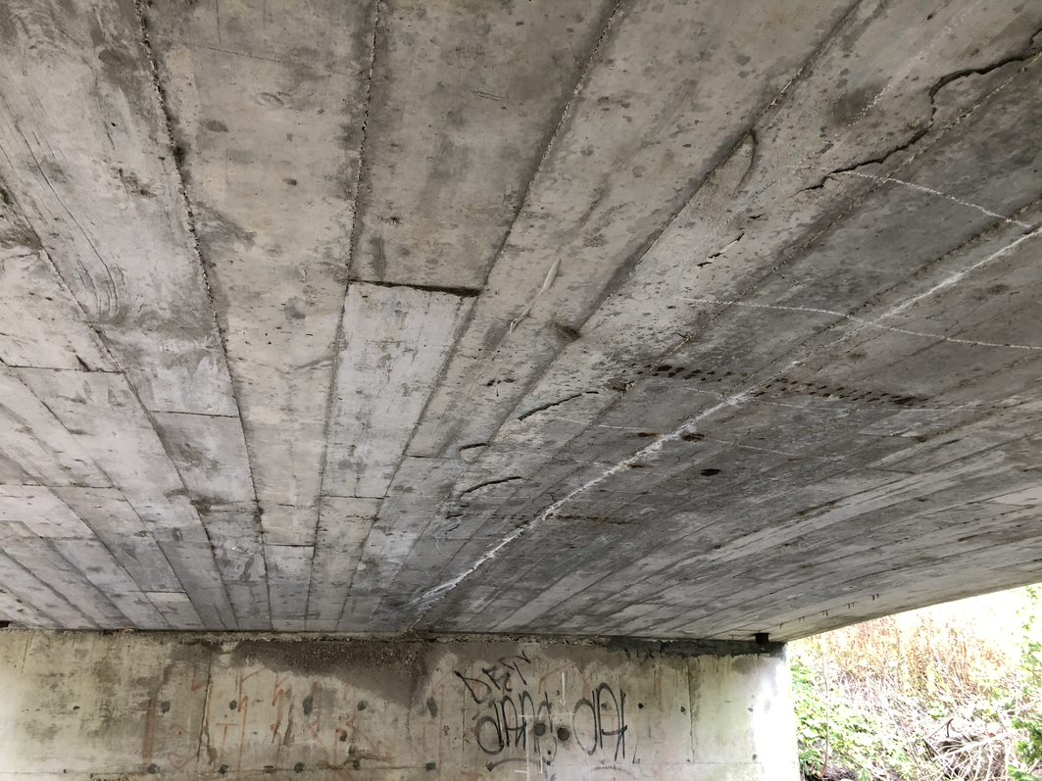
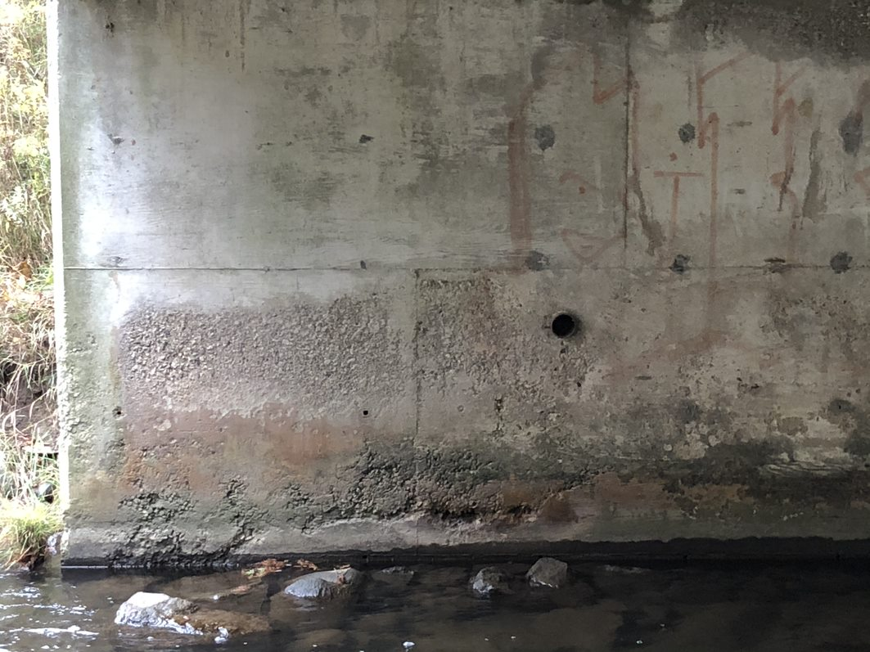
Patterson Sideroad Bridge 2
The existing bridge is a narrow 2-lane, cast-in-place concrete rigid frame structure. The bridge has a 13.7 m (+/-) span, an overall structure width of 8.7 m (+/-) and a 7.67 m driving platform width between barriers. The bridge is located over the Humber River on Patterson Side Road, approximately 20 m east of Duffy’s Lane.
.
Physical Condition:
Age: 65 years old (constructed in 1957).
2001 rehabilitation including concrete repairs.
Structure is in fair physical condition with minor surface defects (scaling and narrow cracks) throughout. Delaminations, spalling, and medium to wide cracking with efflorescence (indicating moisture penetration) were noted on the soffit.
Deck condition survey (2019) identified probable active corrosion of reinforcing steel in majority of deck and substructure.
Noted defects at the structure could be repaired as part of a major rehabilitation of the bridge by completing concrete patch repairs. Deck top repairs would require a concrete overlay.
The watercourse flows along the west abutment which has caused erosion along toe of the slope.
Crack on Barrier Wall
Crack with Efflorescence on Soffit
Delamination on Soffit
Honeycombing on Abutment
Notes:
The Patterson Side Road Bridge 2 is a narrow 2-lane concrete structure that was built in 1957. Rehabilitation of the structure was completed in 2001, including concrete repairs. The bridge has an overall structure width of 8.7m and a driving platform of 7.67m between concrete barriers. The bridge is in fair physical condition with minor surface defects and some active corrosion of reinforcing steel in the majority of the deck and substructure. The structural defects could be repaired as part of a major rehabilitation including the completion of various concrete patch repairs and installation of a deck top concrete overlay.

Slide 9
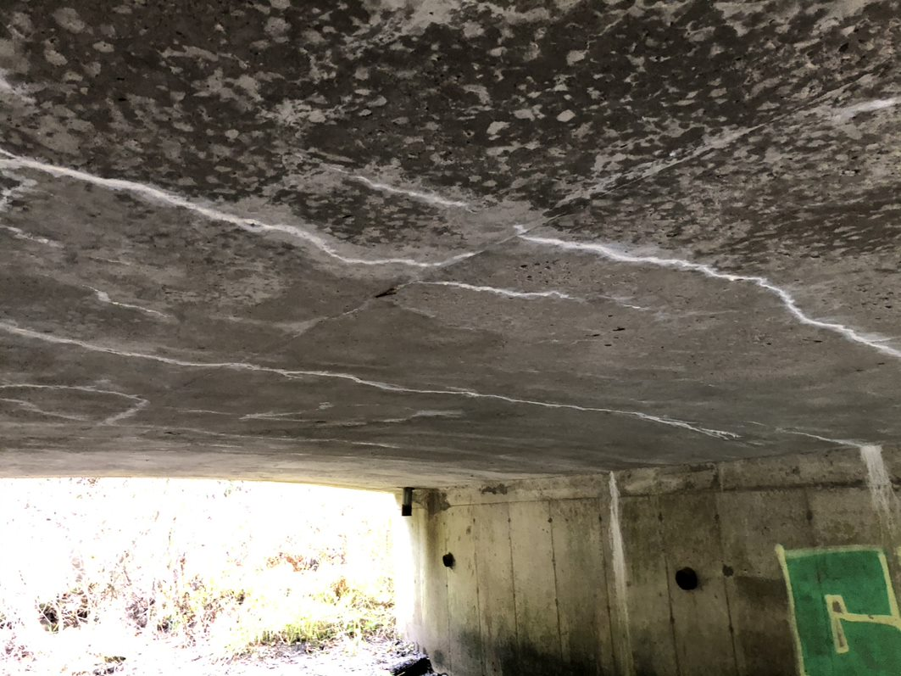
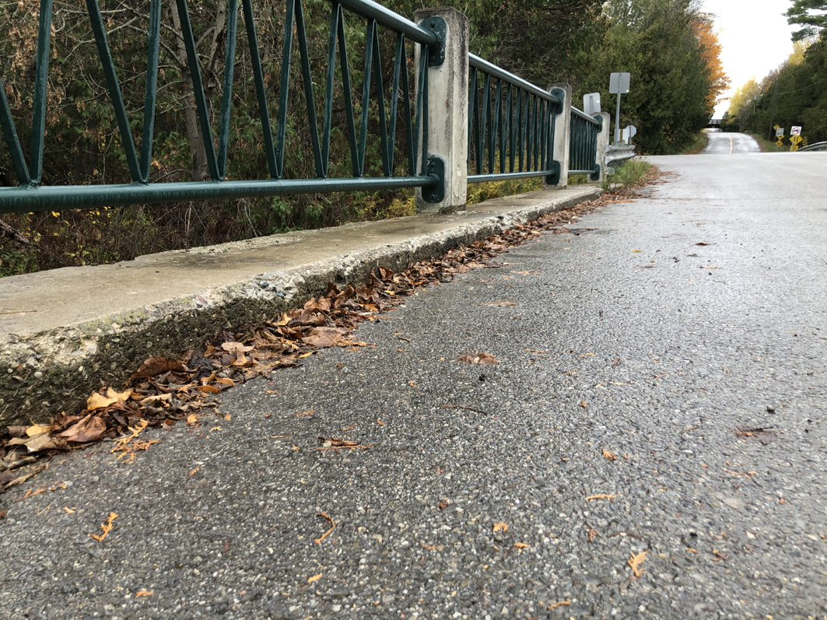
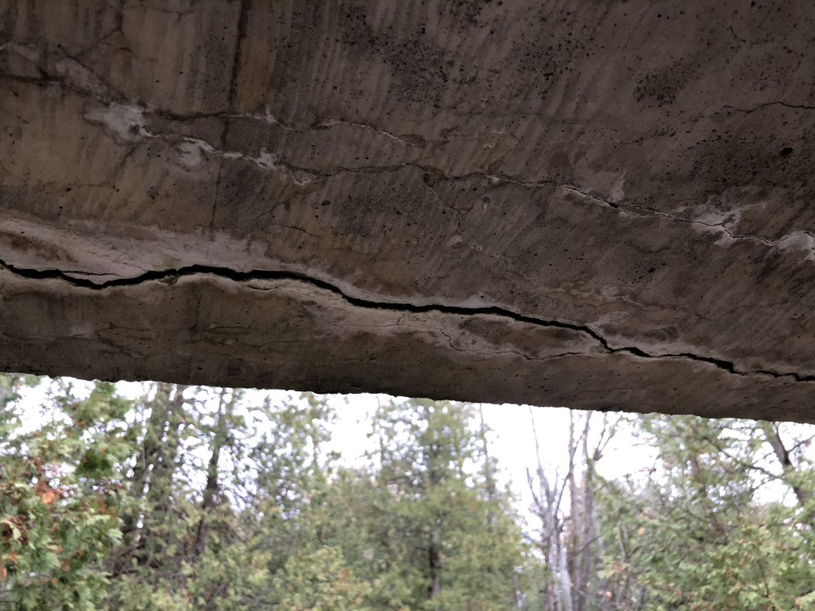
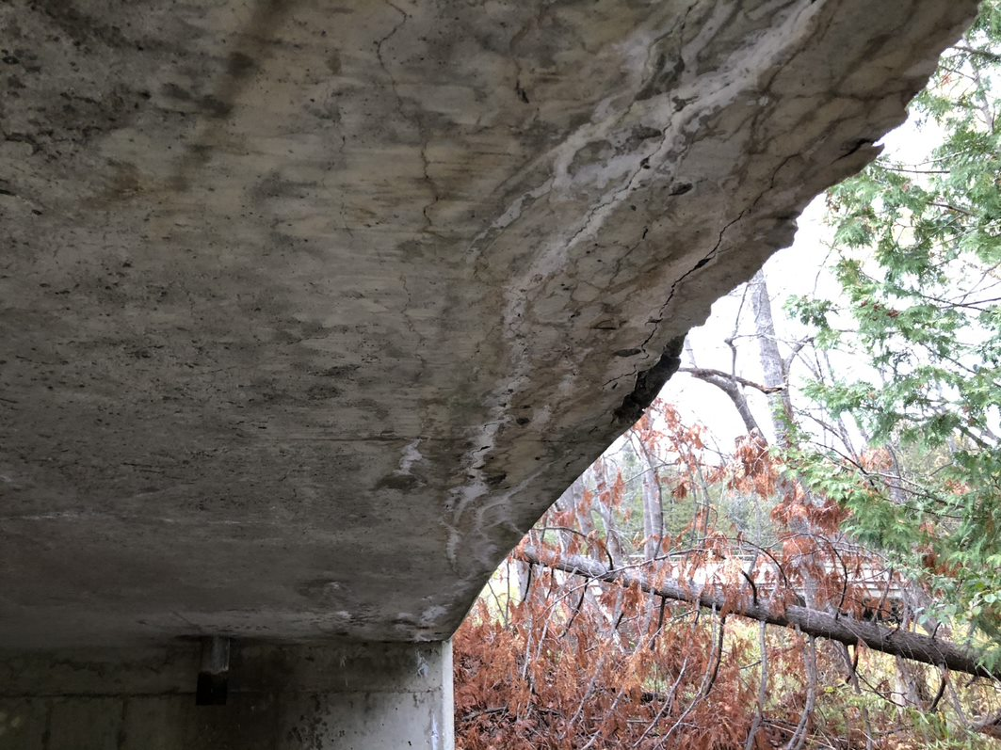
Duffy’s Lane Bridge
The existing bridge is a narrow 2-lane, cast-in-place concrete rigid frame, arch soffit structure and is located on an undivided road. The bridge has a 9.1 m (+/-) span, an overall structure width of 8.8 m (+/-) and a 7.3 m (+/-) driving platform width between raised concrete curbs. The bridge is founded on wooden piles and is located over a tributary of the Humber River, approximately 30 m south of Patterson Side Road.
.
Physical Condition:
Age: 64 years old (constructed in 1957).
Minor rehabilitation in 2000: Various concrete repairs, replacement of the existing barrier system.
Deck condition survey (2015) indicated presence of a concrete overlay which may have been installed during 2000 rehabilitation.
Generally, in fair to poor condition. Concrete repairs recommended on deck, substructure, with curb & barrier replacement. Significant concrete repairs may be required on the deck & soffit, which is in poor condition.
The road is classified as a ‘special road’, with low traffic volumes, and a 40km/hr design speed.
No visual signs of stress/cracking based on current use/loading.
Cracks With Efflorescence on Soffit
Spalls and Scaling on Curb
Crack on Soffit
Delamination along Soffit
Notes:
Duffy’s Lane bridge is a narrow 2-lane concrete structure, that is founded on wooden piles and was built in 1957. Minor rehabilitation of the structure was completed in 2000, including various concrete repairs and replacement of the existing barrier system. The bridge has an overall structure width of 8.8m and a driving platform of 7.3m between raised concrete curbs. The bridge is in fair to poor physical condition with concrete repairs recommended on the deck and substructure, and replacement of the curb and barrier. Significant concrete repairs may be required on the deck and soffit. Visual signs of stress as a result of current use or loading were not observed. The road is classified as a ‘special road’, with low traffic volumes, and a 40km/hr design speed.

Slide 10
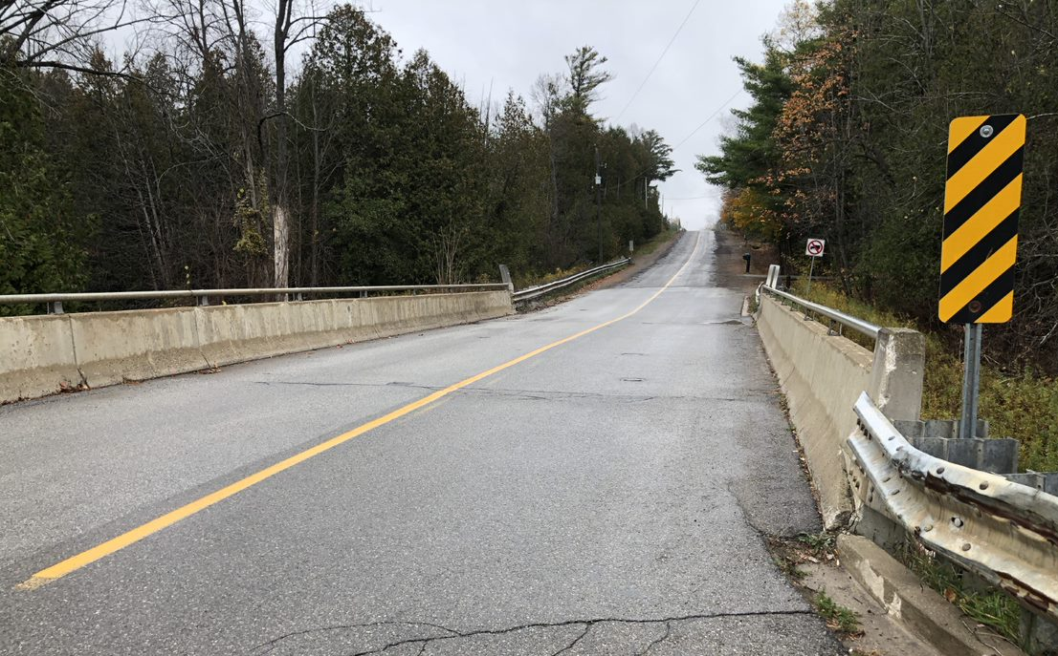
Technical Environment
Geometry – Width
Patterson Sideroad Bridges
Roadway approach is two 3.0-3.5 m paved lanes and gravel shoulders ranging between 0.5-1.0m in width.
Roadway platform narrows at bridge to two-lane bridge with driving platforms of 6.4 m (Bridge 1) and 7.67 (Bridge 2) between barriers.
Transportation Association Canada (TAC) recommends a minimum 10.0m wide driving platform for design speeds less than 70km/h, or 11.0m wide platform for 80 km/h design speed.
Caledon Transportation Master Plan (TMP) identifies Patterson Sideroad in the Recommended Cycling Network as a Shared On-Road Cycling Route. – Minimum 1.5 m Signed Bikeway.
Existing driving platform is functionally deficient based on current TAC standards and the TMP.
Driving platform width between barriers should be 10.0 m (as per TAC Manual and Ministry of Transportation (MTO) supplemental guides).
Duffy’s Lane Bridge
Roadway approach is approximately 7.25 - 7.5 m wide paved platform. South of bridge, gravel roadway with 5.75 - 6 m platform width with 1.25 - 1.5 m shoulders.
Platform between raised curbs on the structure is approximately 7.3 m.
Road is classified as a ‘special road’ based on low traffic volumes. MTO Structural Design Manual allows for minimum of 2.75 m lane widths and 0.25 m shoulder widths under such designations.
Low-volume, no-exit nature of road may allow for reduced driving platform that doesn’t meet TMP requirement of 3.5 m through lanes with 1.5 m wide shoulders for typical rural cross-sections (10 m platform).
Minimum recommended driving platform width for a two-lane, Low Volume Bridge is 7.0 m
Consideration may be given to providing a single lane, two-way structure with right-of-way control signage due to Low Volumes. Minimum recommended width for single lane structure would be approx. 4.15 m.
Notes:
The selection of a preferred solution for the project is based on an evaluation of the design alternatives and the existing conditions within the technical, socio-cultural, financial and natural environment of the Study Area. The following slides provide a summary of the existing conditions in the Study Area for these environments.
The Technical Environment:
The width of Patterson sideroad narrows at each of the bridges from a 7 or 8m wide roadway to a driving platform of 6.4m wide for Bridge 1 and 7.67m wide for Bridge 2. The existing width of the driving platform of both Patterson Sideroad Bridges is considered functionally deficient based on the Caledon Transportation Master Plan and the Transportation Association Canada standards, which recommends a minimum 10m wide driving platform for design speeds less than 70km/hr or 11.0m wide for 80km/hr design speeds. The Caledon Transportation Master Plan identifies Patterson Sideroad in the Recommended Cycling Network as a Shared On-Road Cycling Route with a Minimum 1.5 m Signed Bikeway.
The width of Duffy’s Lane also narrows at the bridge crossing from a 7.25m to 7.5m wide roadway to approximately 7.3m at the bridge. Duffy’s Lane is classified as a no exit, “special road”, with low traffic volumes. The minimum driving platform width for a two-lane, Low Volume Bridge is 7 m. Consideration may be given to providing a single lane, two-way structure with right-of-way control signage due to Low Volumes. The minimum recommended width for a single lane structure would be approximately 4.15 m.

Slide 11
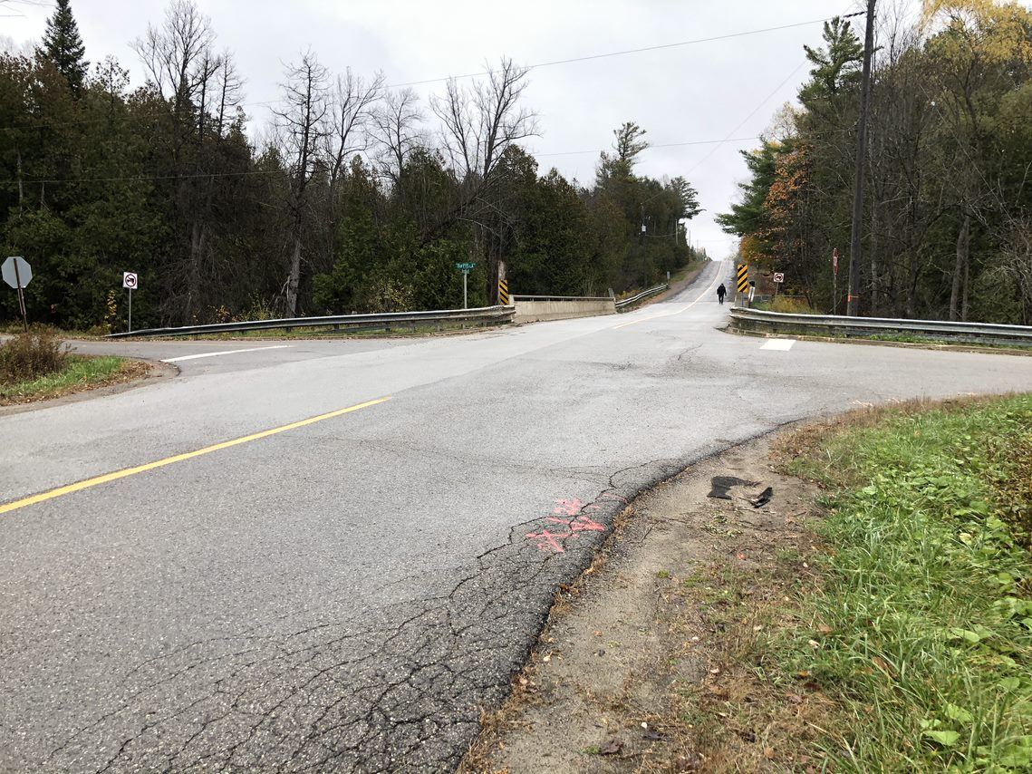
Technical Environment
Geometry – Road Profile
Patterson Sideroad
Rural Collector road with posted speed limit of 60 km/hr.
Structures are on a vertical curve portion of roadway profile.
Morrison Hershfield is currently finalizing design for a reconstruction of Patterson Sideroad. Design speed is recommended to be maintained at posted 60 km/hr.
Patterson Sideroad has abrupt curvatures that may require adjustments to the road profiles: Increase 0.65 m at Bridge 1, 0.45 m at Bridge 2.
Increasing the road profile is for improved sight lines.
Improvements to road profile would require significant structural overlays, strengthening, and load posting.
Duffy’s Lane
Classified as a no exit, “special road”, with limited traffic.
Current road profile has a comparable design speed of approximately 20 km/hr, which is considered sub-standard.
Due to anticipated profile changes along Patterson Sideroad, profile changes will be required at Duffy’s Lane to tie into Patterson Sideroad.
If rehabilitation is preferred alternative, a 30 km/hr design speed is achievable to tie in north end of Duffy’s Lane with raised intersection.
If replacement is preferred alternative, adjustments of 40 km/hr or higher are achievable.
Final profile will depend on geometry of structure.
Notes:
Patterson Sideroad is a Rural Collector road with posted speed limit of 60 km/hr and is currently being considered for reconstruction with no change to the design speed. Adjustments to the road profile may be required as part of the road reconstruction to improve sight lines, as the road has abrupt curvatures. Road profile improvements would require significant structural overlays and strengthening, as well as a load posting at the bridges.
The road profile for Duffy’s Lane has a comparable design speed of approximately 20 km/hr, which is considered sub-standard. Due to its close proximity to Patterson Sideroad Bridge 2, any anticipated changes to the profile of Patterson Sideroad would require profile changes to Duffy’s Lane. Tying in with a raised intersection at Patterson Sideroad could be completed to meet a 30 km/hr design speed with rehabilitation options of the Duffy’s Lane bridge. While an adjusted design speed of 40km/hr or higher is achievable with the replacement of the Duffy’s Lane bridge. However, the final profile would depend on the geometry of the structure.

Slide 12
Technical Environment
Hydraulic Capacity
Patterson Sideroad Bridge 1
Tributary of Humber River at the bridge location:
Flows north to south through structure, then east along the south roadside embankment, and is not well-aligned with the structure.
Depth of 0.2 m to 0.5 m.
Natural channel is 5 to 7 m wide.
Classified as ‘Collector’ Road
Patterson Sideroad Bridge 2
Humber River at the bridge location:
Mainstem of Humber River flows from north to south.
Depth of 0.2 to 0.4 m.
Natural channel is 9 to 11 m wide and is aligned along western abutment.
Classified as ‘Collector’ Road
Duffy’s Lane Bridge
Tributary of Humber River at the bridge location:
Flows west to east.
Depth of 0.25 to 0.35 m.
Natural channel is 3 to 4 m wide. Predominantly flows against northern abutment.
Classified as ‘Local’ Road
Existing structures are sufficiently sized → Structures provide minimum 1.0 m recommended clearance to the soffit during a 50-year flood event.
HEC-RAS Model – Hydraulic Performance of Existing Patterson Sideroad Bridge 1
HEC-RAS Model – Hydraulic Performance of Existing Patterson Sideroad Bridge 2
HEC-RAS Model – Hydraulic Performance of Existing Duffy’s Lane Bridge
Design Event | Design Flow (m³/s) | Headwater Elevation (m) | Soffit Clearance (m) | Depth of Water over Roadway (m)
2-year | 0.28 | 262.93 | -2.28 | N/A
50‑year | 4.53 | 263.51 | -1.78 | N/A
Regional | 68.43 | 266.97 | N/A | 2.83
Design Event | Design Flow (m³/s) | Headwater Elevation (m) | Soffit Clearance (m) | Depth of Water over Roadway (m)
2-year | 2.54 | 261.74 | -2.04 | N/A
50‑year | 15.88 | 262.32 | -1.46 | N/A
Regional | 182.7 | 266.99 | N/A | 2.85
Design Event | Design Flow (m³/s) | Headwater Elevation (m) | Soffit Clearance (m) | Depth of Water over Roadway (m)
2-year | 0.28 | 261.28 | -2.50 | N/A
50‑year | 4.53 | 261.93 | -1.85 | N/A
Regional | 68.43 | 266.97 | N/A | 4.57
Notes:
The Patterson Sideroad Bridges are on a ‘Collector’ Road and, as such, are required to convey 50-year return period rainfall events with a minimum clearance of 1.0m between the underside of the bridge to the 50-year flood event water levels. Additionally, it is recommended that a minimum 1.0m freeboard be met for Collect Roads as well. Freeboard is a measure of the elevation difference between the edge of the travelled road to the water level during the design flood event. The Minimum Freeboard criteria is met at the bridge locations; however, the road profile can not provide the minimum freeboard at the low point of the road without introducing additional fill. Raising the low point of the road with additional fill is not possible due to the negative consequence of increasing upstream flood elevations. Overall, increased structure sizes through replacement would improve hydraulic capacities, but the 1.0m freeboard criteria at the low point of Patterson Sideroad would still not be achieved. Rehabilitation and widening options would have minimal impacts to the existing hydraulics.
Duffy’s Lane is a low volume ‘Local’ Road and as such, the structure must convey the 25-year flood event while maintaining a minimum 0.3 m of clearance from the underside of the bridge, and a minimum 0.3 m of freeboard. The existing structure exceeds both of these requirements. Generally, rehabilitation of the structure would have negligible impacts on the hydraulics, and all replacement options would maintain or improve the hydraulic capacity of the structure.

Slide 13

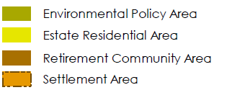
Socio-Cultural Environment
Town of Caledon Official Plan: Schedule A:
Land Use Plan
The EA is guided by the Town’s strategic planning documents, including:
Town of Caledon Official Plan (April, 2018)
Town of Caledon Transportation Master Plan (October, 2017)
Provincial Standards and Design Guidelines
Seasonal population/ fluctuating demand
Planning and Environmental Policies
includes but is not limited to:
Conservation Authorities Act
All structures are within Regulated Areas of the Toronto Region Conservation Authority
Oak Ridges Moraine Conservation Plan (ORMCP)
All structures are within ORMCP Natural Core Area (protects lands with the greatest concentrations of key natural heritage features which are critical to maintaining the integrity of the Moraine as a whole).
  existing uses and very restricted new transportation and utility uses are permitted
Region of Peel Official Plan
All structures are within Natural Core Area within the Official Plan Greenlands System.
  Infrastructure authorized under a pre-approved environmental assessment process may be permitted within the Greenlands designation
Town of Caledon Official Plan
All structures are within the Official Plan Environmental Policy Area (includes all Natural Core Areas and Natural Corridors)
  Essential infrastructure is permitted
No local water source- Oliphant
Small user base to defray fixed costs
6
Notes:
The Socio-Cultural Environment:
The EA is guided by the Town’s strategic planning documents, including Town of Caledon Official Plan and the Town of Caledon Transportation Master Plan, as well as the regional official plan and Provincial Standards and Guidelines. The Study Area is located within Regulated Areas of the Toronto Region Conservation Authority, as well as an Oak Ridges Moraine Conservation Natural Core Area, where existing uses and very restricted new transportation and utility uses are permitted.
The Study Area is also located within the Natural Core Area of the Greenland System within the Region of Peel Official Plan, and within the Environmental Policy Area of the Town of Caledon Official Plan. Infrastructure authorized under the Municipal Class EA process or essential infrastructure is permitted.

Slide 14
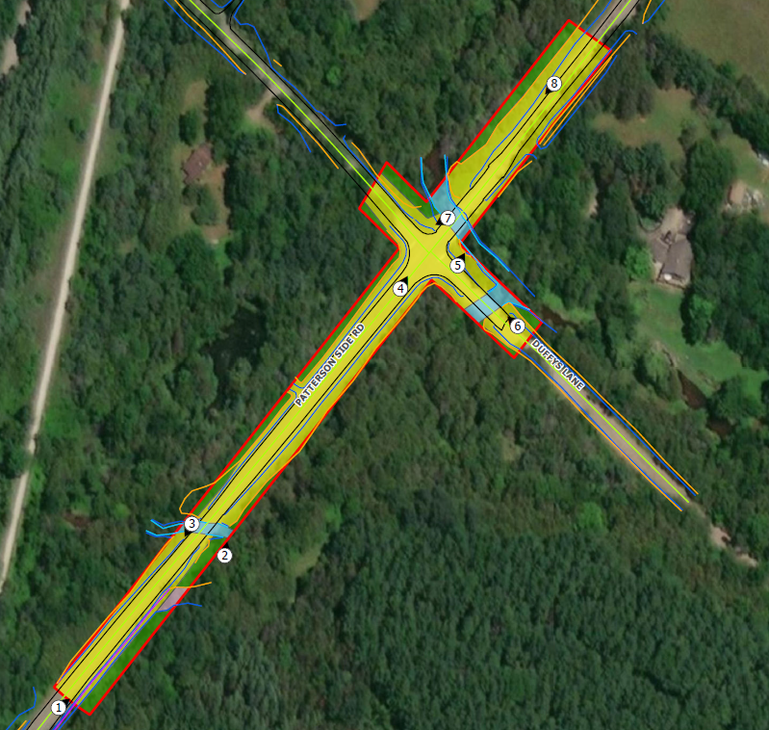
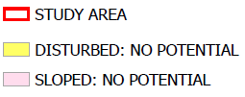
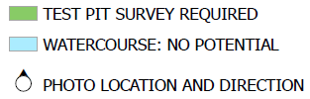

Socio-Cultural Environment
Archaeological Resources
Stage 1 archaeological study determined that parts of the Study Area have archaeological potential
Stage 2 archaeological assessment (test pit survey) is required prior to any construction activities, if areas are impacted.
Results of Stage 1 Archaeological Assessment, ASI Jan 2021
Cultural Heritage
The subject bridges are not listed on the Town of Caledon’s Heritage Register, designated under Part IV of the Ontario Heritage Act, or identified on the Ontario Heritage Bridge List.
Bridge No. 1 and Bridge No. 2 were determined not to have cultural heritage value as outlined in O.Reg. 9/06.
Duffy’s Lane Bridge is considered a cultural heritage resource (based on existing barrier), eligible for designation under the Ontario Heritage Act based on its context and physical attributes.
Duffy’s Lane Bridge, Cultural Heritage Resource Assessment, ASI Jan 2021
Notes:
A Stage 1 archaeological assessment determined that parts of the study area have archaeological potential and will require Stage 2 archaeological assessment prior to any construction activities, if these areas will be impacted. The specifics on the location of future infrastructure placement and construction activities will be determined during the later stages of the project.
The subject bridges are not listed on the Town of Caledon’s Heritage Register nor are they identified on the Ontario Heritage Bridge List. Patterson Sideroad Bridge 1 and Bridge 2 were determined not to have cultural heritage value; However, Duffy’s Lane Bridge is considered a cultural heritage resource due to its existing barrier feature and is eligible for designation under the Ontario Heritage Act based on its context and physical attributes.

Slide 15
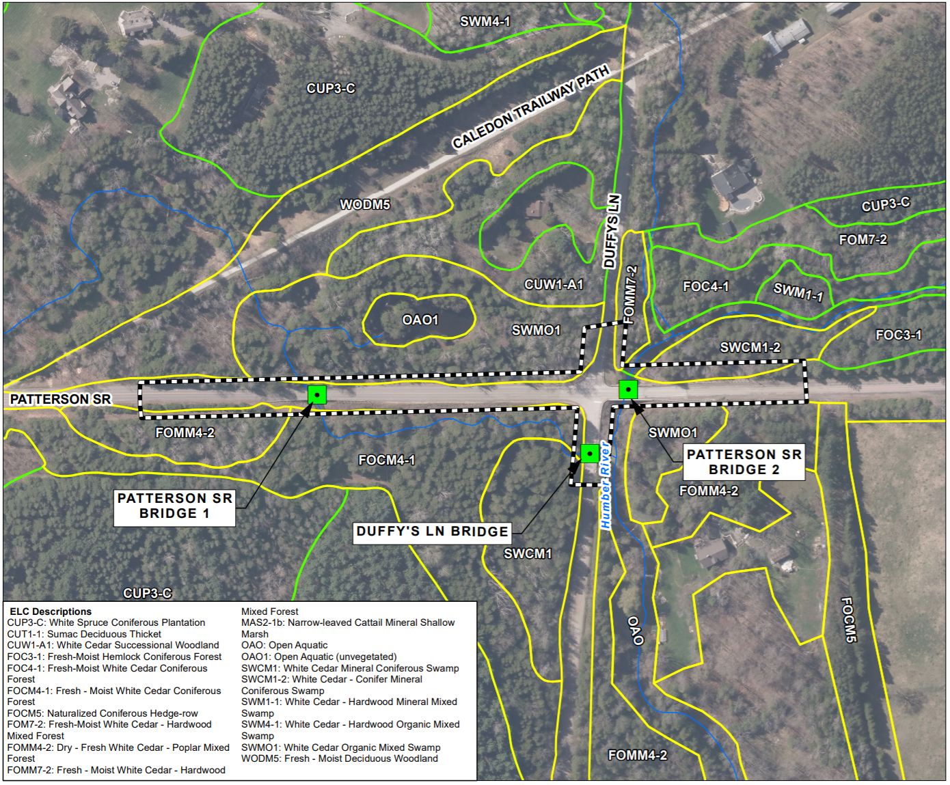
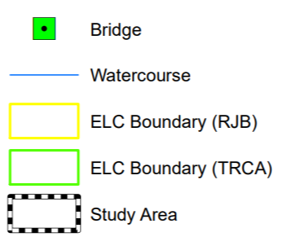
Natural Environment
Vegetation Communities
8 vegetation communities including open aquatic and treed vegetation communities in the Study Area- All are considered relatively common in Ontario
Aquatic Habitat
Humber River and tributary
No fish observed, although watercourse is suitable to provide fish habitat.
Species at Risk
Suitable habitat for Barn Swallow (Provincially Special Concern). No evidence of nesting and no Barn Swallows were observed.
  Potential for bat roosting habitat within the forest and treed swamp (several bat species are Provincially Endangered).
  Potential habitat for Snapping Turtle and Midland Painted Turtle, Monarch Butterfly (Provincially Special Concern or Specially Protected reptile species)
Notes:
The Natural Environment:
The assessment of the natural environment was completed through a background information review and field investigations to characterize the terrestrial and aquatic environments within the Study Area. The Study Area includes wetland, treed and open aquatic areas. In the greater area, beyond the Study Area, adjacent lands include rural residential properties and natural forest and wetland communities. The Humber River flows under Patterson Sideroad Bridge 2 while a tributary of the Humber River flows under Duffy’s Lane bridge and Patterson Sideroad bridge 1. Both watercourses are considered fish habitat under the Fisheries Act.
The vegetation communities observed in the Study Area are considered to be relatively common in Ontario. No sensitive vegetation communities or provincially significant plant species were observed within the Study Area during the field assessment. Suitable habitat for Barn Swallows, a provincially species of Special Concern, were found on all three bridges, although no evidence of past or active nesting was observed, and no Barn Swallows were observed during the site assessment. Within the forest and treed swamp in the Study Area several trees appeared to provide suitable habitat for Provincially Endangered roosting bats. Suitable habitat for Snapping Turtles may be present in waterbodies or ponds located beyond the Study Area. Open watercourse features in the Study Area appear to provide suitable habitat for Midland Painted Turtle.

Slide 16
Alternative Solutions
Patterson Bridge #1 and Bridge #2
Alternative Solution | Description
 | Patterson Bridge #1 | Patterson Bridge #2
1) Do Nothing | Mandatory requirement for consideration in a Class EA. Maintain the status quo. Allows for structure to live out remaining service life
2) Rehabilitate Structure | Removal of existing curb and barrier, partial concrete depth repairs, removal of existing asphalt and replace with new asphalt and waterproofing, and removal of existing granular fill on deck and install reinforced concrete slab on existing deck. | Partial depth concrete repairs on soffit and on deck top, removal of existing barrier and installation of TL-4 parapet with railing, partial depth concrete repairs on substructure, scarify existing deck and place concrete overlay, asphalt and waterproofing
3) Rehabilitate and Widen Structure | Rehabilitation efforts from Alternative 2 plus deck and abutment widening, footing widening and steel piles on footing extensions. | Rehabilitation effort from Alternative 2 plus deck, abutment and footing widening, steel piles on footing extensions.
4) Replace Structure | Full structure replacement with a 16.25 m span bridge. Includes ability to improve alignment with watercourse and widen structure to meet desired road platform width. | Full structure replacement with a 14.0 m span bridge. New structure can be constructed to desired platform width and can allow for improved sight distance to meet 60km/hr design speed.
Notes:
The alternative solutions that were developed are feasible within the project environment and meet the project objectives outlined in the Problem/Opportunity Statement. Alternative solutions that address increased traffic and structural conditions of the Patterson Sideroad bridges 1 and 2 include: 1) Do Nothing, a mandatory requirement for consideration in the Municipal Class EA process 2) Rehabilitate the structure 3) Rehabilitate and widen the structure 4) Replace the structure.

Slide 17
Alternative Solutions
Duffy’s Lane Bridge
Alternative Solution | Description
1) Do Nothing – | Mandatory requirement for consideration in a Class EA. Maintain the status quo. Allows for structure to live out remaining service life (anticipated 5-10 years). Structure would be removed of at end of service life and roadway dead-ended at structure.
2) Abandon/Remove Structure and Close the Road | Structure would be removed before its end of service life and roadway closed at structure.
3) Rehabilitate Structure | Partial depth concrete repairs on soffit, deck top, and substructure, removal and replacement of barrier system, full depth curb removal and reconstruction of outer deck edges and wingwall tops, removal of asphalt wearing surface, installation of erosion and scour protection.
4a) Replace Structure Vehicular Bridge – Two-Lane | Replacement of existing structure with a two-lane vehicular bridge that has a slightly larger span and width to meet Town Standard driving platform, designed to full vehicular load requirements and road profile improvements.
4b) Replace Structure Vehicular Bridge – Single-Lane, Modular | One-lane, two-way structure that would provide a 4.2 m (+/-) wide driving platform as a pre-fabricated girder-type structure. The new structure would allow for a larger span and new bridge abutments and would allow for road profile improvements.
4c) Replace Structure Pedestrian Bridge | Eliminate vehicular access and limit the capacity to pedestrian and bicycle crossing only. A 2.4 m platform and 15 m long span is being considered.
Notes:
Alternative solutions that address increased traffic and structural conditions of the Duffy’s Lane bridge includes: 1)Do Nothing, 2) Abandon or remove the structure and close the road, 3)Rehabilitate the structure, 4) Replace the structure with
a) a two-lane bridge, b) a single lane modular bridge, or c) a pedestrian bridge.

Slide 18




Evaluation of Alternative Solutions
The alternative solutions for bridge and road reconstruction in the Study Area are evaluated at a high level relative to each other against a set of criteria. Potential criteria are provided below under each of the project environments:
Natural Environment
Impact to Water Quality and Quantity
Impact to Aquatic Habitat
Impact to Vegetation and Terrestrial Habitat
Impact to Designated Sites/Species at Risk/Rare Species
Climate Change (greenhouse gas emissions, carbon storage)
Socio-Cultural Environment
Conformity to Local Planning Provisions (planned road improvements, Active Transportation policy)
Property Impacts (property acquisition)
Impact to Archaeological Resources
Impact to Cultural Heritage Resources
Financial Environment
Capital Costs
Operating and Maintenance
Net Present Value
Technical Environment
Structural - Condition and Load Capacity
Geometry - Road and Bridge Profile and Width
18
Notes:
Impacts of the alternative solutions are evaluated against the inventory of the natural, social/cultural, financial and technical environment of the Study Area, and includes an evaluation of mitigation measures. The alternative solutions are then compared to each other based on the level of anticipated impact for each criterion. The evaluation leads to the identification of a recommended solution. A summary of the criteria is provided under each environment category. The criteria were developed following a review of the existing conditions in the Study Area.
Key considerations in the development and evaluation of the alternative solutions for the Study Area include;
Potential impact to existing natural features
Minimizing encroachment on private property and the potential for land acquisition,
Maintaining property access,
Consideration of active transportation along the corridor
Working within existing planning policy and regulations
Maintaining traffic flow and connection in the Town as well as providing capacity for future growth and traffic,
Maintaining effective storm drainage
Financial costs
Potential impact to utilities, and
Consideration of community and agency input.

Slide 19
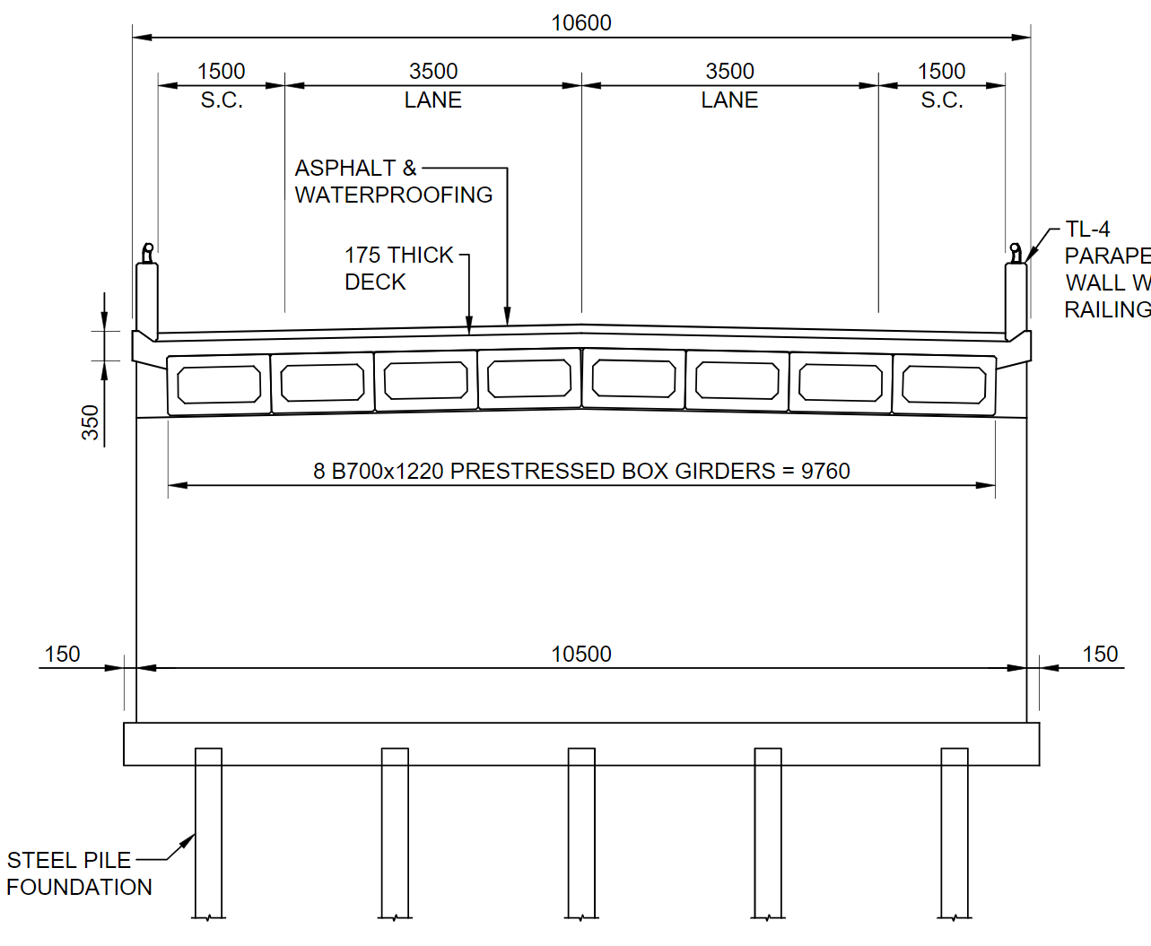
Evaluation of Alternative Solutions
Patterson Sideroad Bridge #1
Preliminary Preferred Solution
Alternative 4- Replace Structure
Full structure replacement with a 16.25 m span bridge.
Includes ability to improve alignment with watercourse and widen structure to meet desired road platform width.
23
Notes:
The alternatives are compared to each other by applying a ranking from most preferred to least preferred based on the level of anticipated impact for each criterion, with a full pie representing the least anticipated impact, and therefore most preferred, to an empty pie representing the greatest anticipated impact, and therefore least preferred. The table provides a summary of the Evaluation of Alternatives as an average range under each environment category. The evaluation leads to the identification of a preliminary Preferred Alternative.
For Patterson Bridge 1, when compared to the other alternatives, the Do Nothing alternative is anticipated to have the most impact on the natural environment due to continued erosion and scouring around the abutment and ongoing impacts to water quality from road salt/sediment run-off from bridge. The Do Nothing alternative will not be able to provide a road network that is efficient and accommodates future level of service. The do nothing alternative will also impose operating and maintenance costs for continued safety at the bridge which will increase over time. The Do Nothing option does not address the Problem or Opportunity Statement and therefore is not preferred.
Alternative 2, Rehabilitate the Structure is the option that has the least socio-cultural impact and is the least expensive option, with similar natural environment level of impacts, however from a technical standpoint, it will not provide improvement to driving platform width compared to the Alternatives 3 and 4.
Alternative 3, Rehabilitate and Widen the Structure, and Alternative 4, Replace the Structure have a similar level of impact under the natural and socio-cultural environments with similar cost, however, from a technical standpoint, Alternative 4 includes the ability to improve alignment with watercourse and widen structure to meet desired road platform width.
Alternative 4- Replace Structure, received the most favorable overall ranking when compared to the other alternatives and therefore is the preliminary preferred solution. This alternative includes a full structure replacement with a 16.25 m span bridge.

Slide 20


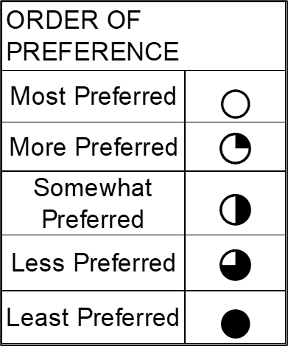
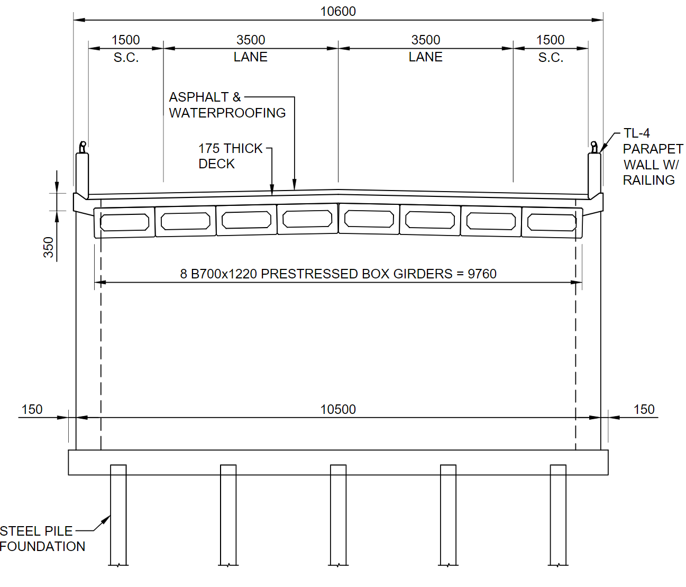
Evaluation of Alternative Solutions
Patterson Sideroad Bridge #2
Preliminary Preferred Solution
Alternative 4- Replace Structure
Full structure replacement with a 14.0 m span bridge.
New structure can be constructed to desired platform width and can allow for improved sight distance to meet 60km/hr design speed.
24
Notes:
Regarding Patterson Sideroad Bridge 2, the Do Nothing alternative is anticipated to have a lesser impact on the natural environment, as compared with the other alternatives, with no anticipated impacts to terrestrial and aquatic habitat. However, ongoing impacts to water quality from road salt/sediment run-off from bridge are possible. The Do Nothing alternatives does not require any capital costs, however, operating and maintenance costs will increase over time. The Do Nothing alternative does not provide any improvement to driving platform width or profile and sight lines, and therefore, does not provide a road network that is efficient and accommodates future level of service. The Do Nothing option does not address the Problem or Opportunity Statement and therefore is not preferred.
Alternative 2, Rehabilitate the Structure is the option that has the least socio-cultural impact and is the least expensive option, and would provide an improved road network that operates at an acceptable level of service, however from a technical standpoint, it does not meet Town standards for platform width and cannot accommodate the shared on-road bicycle lanes or provide the recommended side clearances.
Alternative 3, Rehabilitate and Widen the Structure, and Alternative 4, Replace the Structure have similar overall cost. The replacement of the existing structure with one of a larger-span and increased vertical profile as outlined in Alternative 4, would allow for improved water conveyance capacity below Patterson Sideroad during periods of high flow, providing resilience under changing climatic conditions. Additionally, from a technical standpoint Alternative 4 provides the opportunity for full improvement to the road profile, and sight lines and sight distance can be improved to meet a 60 km/h design speed.
Alternative 4- Replace the Structure, received the most favorable overall ranking when compared to the other alternatives and is the preliminary preferred solution. This alternative includes the replacement of the full structure with a 14 m span bridge.

Slide 21

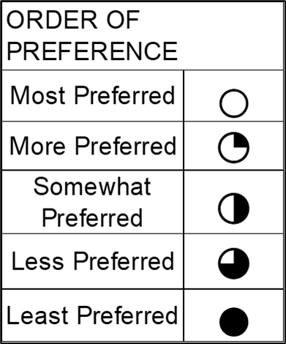
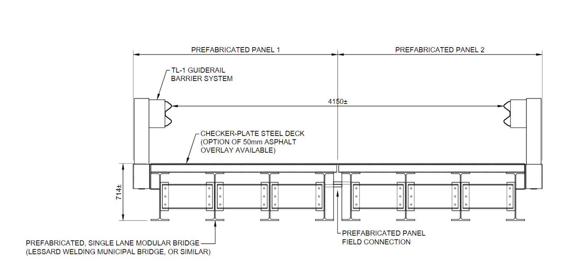
Evaluation of Alternative Solutions
Duffy’s Lane Bridge
Preliminary Preferred Solution
Alternative 3B- Replace Structure with Vehicular Bridge (Single Lane, Modular)
One-lane, two-way structure with a 4.15 m (+/-) wide driving platform as a pre-fabricated girder-type structure.
The new structure would allow for a larger span and new bridge abutments and would allow for road profile improvements.
24
Notes:
At Duffy’s Lane Bridge, the Do Nothing alternative is anticipated to have a lesser impact on the natural environment, with no near-term impact to terrestrial and aquatic habitat. The Do Nothing alternative maintains the existing vertical profile of the bridge, which is vulnerable to potential flood conditions during periods of very high flow and climate extremes. Although Do Nothing does not require any capital costs, operating and maintenance costs will increase over time. Additionally, the Do Nothing alternative does not provide any improvements to platform and side clearance. Load posting would need to be considered due to corrosion of reinforcing steel.
Alternative 2, Abandon/Remove the Structure and Close the Road, is one of the less expensive options overall with moderate costs for structure removal and minimal maintenance cost. From a cultural standpoint, the bridge was determined to have cultural heritage value for physical and contextual reasons and the removal of the structure will be considered a substantial impact to the heritage value.
Alternative 3, Rehabilitation of the Structure, is anticipated to be relatively expensive and would not provide an opportunity to improve profile and sight lines of the bridge to increase the design speed of the road.
Alternatives 4A the replacement of the structure with a two-lane bridge, and 4B, the replacement of the structure with a single-lane bridge, would provide an opportunity to improve the both the profile and sight lines of the bridge. Alternative 4A could also be designed to meet the desirable two-lane platform width. Alternatives 4A and 4B, however, are more costly compared to Alternative 3.
Alternative 4C, Pedestrian Bridge, requires a complete bridge replacement which would have a substantial impact the heritage value of the structure. Without a vehicular bridge, Duffy's Lane would no longer act as a local road. Costs associated with the replacement of the bridge with a pedestrian crossing are anticipated to be moderate with low initial operating and maintenance costs.
Overall, Alternative 4B- Vehicular Single Lane Bridge, received the most favorable ranking when compared to the other alternatives and therefore is the preliminary preferred solution. This alternative includes a one-lane, two-way structure with a 4.15 m wide driving platform which would allow for a larger span and road profile improvements.

Slide 22
EA Project Timeline
Phase 1- Problem or Opportunity
  Review available information and studies
  Identify the Problem or Opportunity
  Notice of Commencement and Public Information
Winter 2021
  Identify Alternative Solutions
  Inventory of the Environment
  Identify Impacts and Mitigation Measures
  Evaluate Alternative Solutions
  Select Preferred Solution
  Confirm EA Schedule (Schedule B or C)
Winter 2022/23
Phase 2- Alternative Solutions
Public Information Centre
  Document the EA planning process for public review
  Notice of Completion and Public Review
Spring/Summer 2023
Project File Report
Review public, stakeholder and Agency comments generated from this Public Information Centre (for this phase of the project, please submit your comments by May 31st, 2023);
Select Preferred Solution;
Issue Notice of Study Completion and provide Project File Report (PFR) for public review and comment for a period of 30 days.
Next Steps...
25
Notes:
This Municipal Class Environmental Assessment was initiated with the notice of commencement issued in February 2021. Following the input received from this PIC, the Study Team will confirm the preferred alternatives. The Municipal Class Environmental Assessment process , including the input from the public, agencies, Indigenous communities and stakeholders will be documented in a Project File Report and made available for public review and comment for a period of 30-days following the Notice of Completion of the project. At this time, it is anticipated that the Notice of Completion and the Project File Report will be available in the Spring/Summer of 2023.

Slide 23
Thank you for participating
Help shape decisions made in this Study
Please complete the comment form available on the Town's website at the link provided.
Information materials about the study will be made available online at: ic12esolg.ca/11187116_TownofCaledon/en/news/public-ntice-patterson-duffy-s-lane-bridge-environmental-assessment.aspx for review and comment until May 31st, 2023.
A summary of your written comments along with responses to comments received by May 31st, 2023 will be provided in a Public Information Centre Summary report posted on the project page of the Town’s website.
If you would like more information or if you have any questions or concerns please contact:
George Golding, P.Eng. Project Manager, Engineering Capital Design & Construction, Engineering Services Department | Andrew Dawson, P.Eng. Project Engineer
Town of Caledon | R. J. Burnside & Associates Limited
6311 Old Church Road | 15 Townline
Caledon, Ontario L7C 1J6 | Orangeville, ON L9W 3R4
T 905-584-2272 x 4523 | T 705-797-4310
George.Golding@caledon.ca | Andrew.Dawson@rjburnside.com
Project and notice information will be made accessible upon request in accordance with the Accessibility Standard for Information and Communication under the Accessibility for Ontarians with Disabilities Act, 2005. Information will be collected and maintained to meet the requirements of the Environmental Assessment Act and for the purposes of creating a record that will be available to the general public as described in Section 37 of the Freedom of Information and Protection of Privacy Act. With the exception of personal information such as name, address, telephone number and property location, all comments will become part of the public record that is available to the general public.
26
Notes:
Thank you for participating in this Public Information Centre. We ask that you help shape the decisions made as part of this study by encouraging you to complete the comment form available on the Town’s website at the link provided. The presentation materials will be available on the project webpage for review and comment until May 31st, 2023. Responses to comments received by May 31st will be provided in a Public Information Centre Summary report along with a summary of your written comments and posted on the Town’s project webpage. We appreciate your input and look forward to receiving your comments.

